Slide 1
Renewable Survey for Ashton Hayes

Slide 2
Overview
What are the next steps for renewables in Ashton Hayes?
On individual or community buildings
Look at the products
Cost and installation process on a community scale?

Slide 3
Types
Photovoltaics
Wind
Anerobic digestion
Hydro
Biomass

Slide 4
Bulk PV installation
Bulk installation across the village will allow reduction in costs.
Needs management – e.g. ‘village marshal’ to let workers in and out of houses if owners are out during the day – same for retrofitting work.
70 installations with a total capacity of 210kW would generate around 167MWh per year.
Joint planning application
Show planners that this is what the village wants.

Slide 5
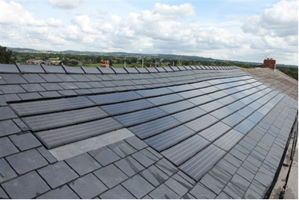
Solar slates
Should be acceptable in the conservation area.
Some even better ‘mimic’ than the example.
One product made from recycled battery plastic.
More expensive but a new roof too and can insulate.

Slide 6
Wind
In investigating appropriate turbines the following was taken into account:
The efficiency of the turbine a low wind speed and its cut in wind speed
Requires 18-24 metre tower
Capital cost
The maintenance required.
Whether it is 3 phase or single phase
The noise it produces
MCS accreditations (equivalent accreditations may be allowed in future)

Slide 7
6-11kW Wind Capacity
Individuals have expressed an interest. Other potential sites are the school or playing field.
If the Gaia turbine can be run with a reduced cut-in wind speed this is the best fit to the requirements criteria.
The Eoltec is the next best fit to the requirements although less attractive in terms of cost/kWh produced.
Antaris a good option if a suitable tower height is possible – very few in the UK.
Costs are between £32 000 and £48000

Slide 8
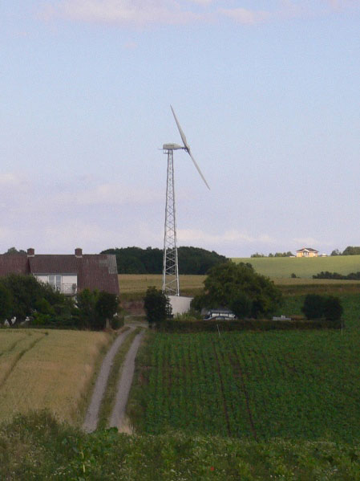
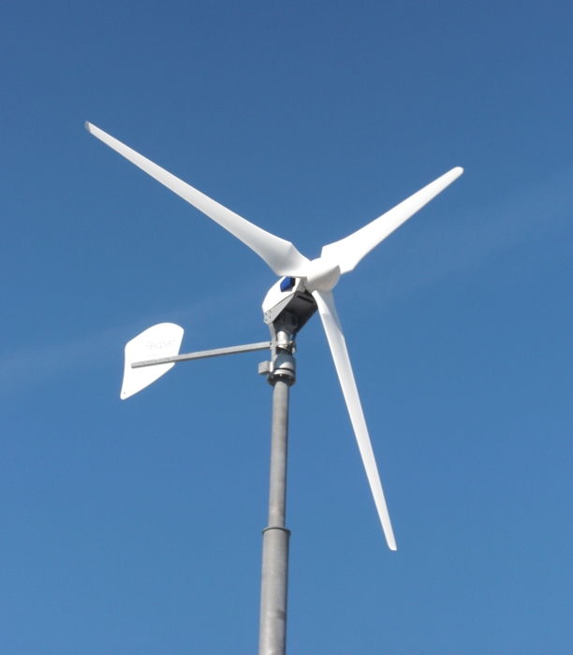
Gaia 10kW
Antaris 6-9kW

Slide 9
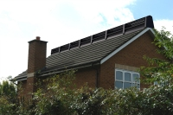
Endurance 50kW
School or playing field are possible sites. Better value for money.
Small Antaris 2.5kW only stand alone turbine suitable
Ridgeblade roof mounted may be more suitable – currently under test.
Under 3kW

Slide 10
Hydro
No technology available for the small streams in the village.
Will continue to investigate and monitor developments.

Slide 11
Anerobic Digestion
‘The muckbuster’ may be suitable to process a few households of waste – replace septic tanks.
May be grass cuttings as well.
Need more work into viability – John Moores University have expressed an interest..
Have to avoid ‘feast and famine’ for the bugs!

